Slide 1

Web scraping to gain company insights

Slide 2
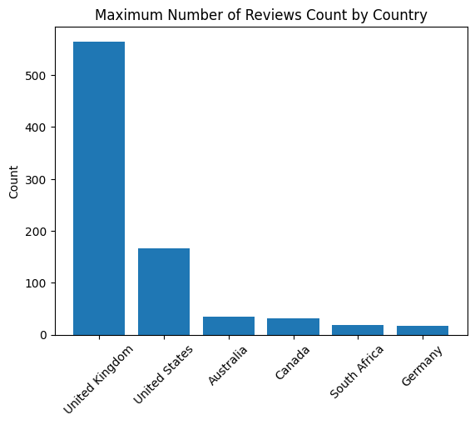
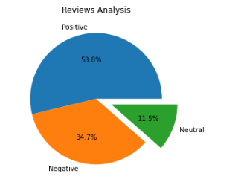
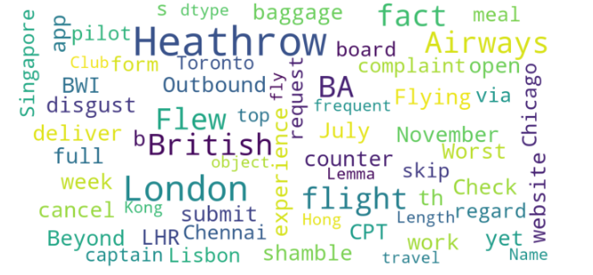
INSIGHTS FROM CUSTOMER REVIEWS
From cleaning 1000 reviews given by the customers, we obtained
Positive Reviews - 500
Negative Reviews - 391
Neutral Reviews – 109
Word cloud of keywords used in reviews
Out of 54 Countries, These are top 6 countries with Maximum Reviews.
Average Overall Rating
4.84 /10

